Slide 1
Lecture 4:
Streams of Sociology
Course: Introduction to Human Sciences

Slide 2
Sociology: Grappling with ‘Modernity’
Modernity was supposed to transform religion, kinship-based, feudal societies.
Religion ------ Secularism
Feudal economies -------- modern, capitalist, industrial mass production, along with planning
Kinship ----- individualised, nuclear families
Feudal and princely rule ------ democratic societies
Resources harnessed for development.
Primordial ties ----- citizenship in a modern state
Robert Merton: ‘unintended consequences’.
Studying contradictions and ‘unintended consequences’

Slide 3
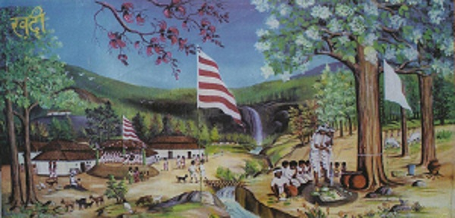
Religion and Sociology
The study of beliefs, practices and value systems of religions, religious/spiritual traditions.

Slide 4
Religion and Sociology
DIFFERENT from THEOLOGY.
WHAT questions to ask?
What is RELIGION/role in society?
Has the idea of ‘religion’ remained constant? If not, what are the changes in the CONCEPT of religion?
What is the relationship between RELIGION, MAGIC, SCIENCE/LOGIC/RATIONALITY?
What NOT to do?
Judge the ultimate ‘truth’ value of religion(s)
Reduce religion to ‘social structure’
Reduce religion to ‘psychic condition’
Use an ‘evolutionary’ scheme to ‘rate’ various religions

Slide 5
Some themes in the study of religions
  Studying ‘beliefs’ and ‘rites’.
    Beliefs: States of opinion (THINKING)
    Rites: Modes of action (DOING)
    ‘PROFANE’ and the ‘SACRED’. TWO DIFFERENT worlds. Needs rites of initiation.
      Sacred: Beliefs, myths, dogmas, legends. Protected and isolated BY prohibitions.
      Profane: Things on which the prohibitions are APPLIED.
  Notion of the ‘SUPERNATURAL’ (anything that is BEYOND our understanding). Speculation on ALL that escapes science/rational thinking.
  CHANGING beliefs/meanings and RITES associated with religions. COMMUNALISATION/SECULARISATION of society.
  EXAMPLES: Study of the rise of ‘Hindutva’, Zionism, Political Islam…

Slide 6
Major ideas on religion
  DURKHEIM:
  Beyond rational/irrational debate
    Religious ideas are NOT the ‘last resort’, sign of ‘despair’, lack of knowledge. They are a way of understanding the world.
    ‘Natural’ and ‘Supernatural’: Supernatural is NOT a world where ‘reason’ does not operate. Religion aims to explain what is constant and regular. NOT what is exceptional and abnormal.
    Religion as a means for SOCIAL COHESION

Slide 7
Major ideas on religion
    WEBER
    Religion as a source of social/economic structures
Calvinists and the capitalistic spirit
  Protestantism: concept of the worldly "calling“. Worldly activity has a religious purpose
  Calvinism: Belief in predestination. Who is ‘saved’ and who is ‘damned’?
  Calvinism paved the way for/contributed to modern capitalism
  Emphasis on ascetic behavior, less consumption, more saving
  Similarly:
  Protestant Reformation and the Scientific Revolution:
  Connections with mass education, utilitarianism, mundane interests, empiricism, questioning of authority
  “the deep rooted religious interests of the day demanded in their forceful implications the systematic, rational, and empirical study of Nature for the glorification of God in His works and the control of the corrupt world”

Slide 8
Major ideas on religion
    Marx and RELIGION
  “Religious suffering is, at one and the same time, the expression of real suffering and a protest against real suffering. Religion is the sigh of the oppressed creature, the heart of a heartless world, and the soul of soulless conditions. It is the opium of the people”

Slide 9

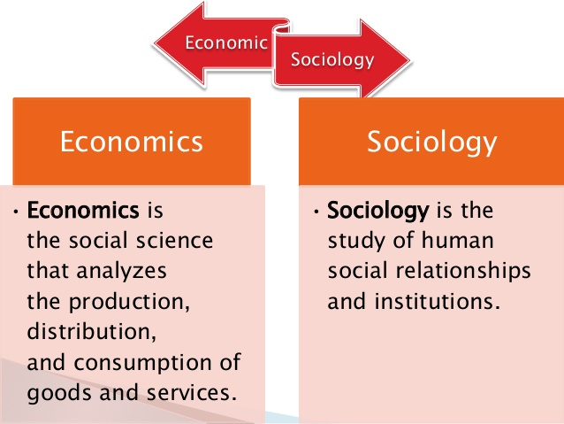
Economic Sociology
Study of the social cause and effects of various economic phenomenon.

Slide 10
Economic Sociology
Systems of production, circulation and consumption:
Hunting and gathering
Domestic mode of production
Peasant mode of agriculture
Capitalist mode of production (mass production, private ownership etc.)
Socialist mode of production
Impacts of various ECONOMIC MODELS on social structures
Impacts of migration/urbanisation
Impacts OF and ON stratification. Emergence of the ‘NEW’ middle class

Slide 11
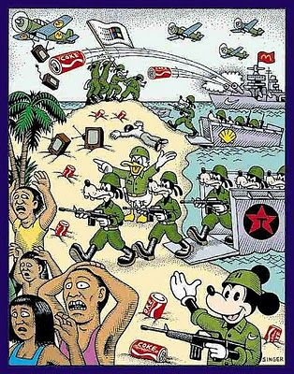
Economic Sociology
ECONOMIC/CULTURAL hegemonization

Slide 12
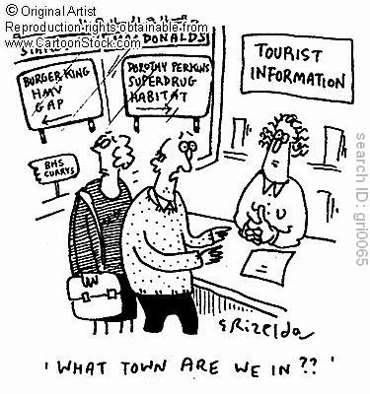
McDonaldisation of culture
HOMOGENISATION of cultures. DOMINANT characteristics of economy:
Efficiency: Discourse concentrates on ‘optimal’, fastest and most economical way to do things.
Calculability: Everything can be quantified/bought in the McDonald culture. QUANTITY becomes more important than QUALITY.
Predictability/standardisation: Mass production, where one expects the same thing every time, everywhere. LESS creativity, LESS variety.
Control: More mechanisation and replacement of human beings. More strict control over employees and the production process.

Slide 13
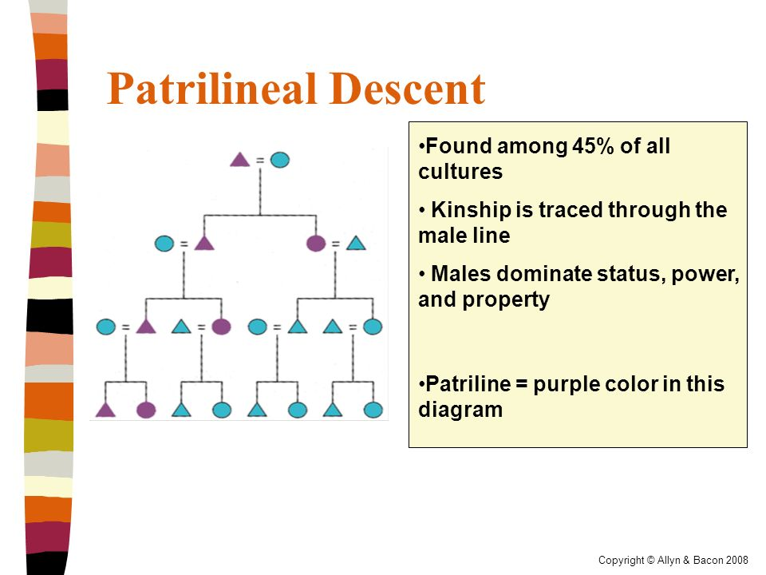
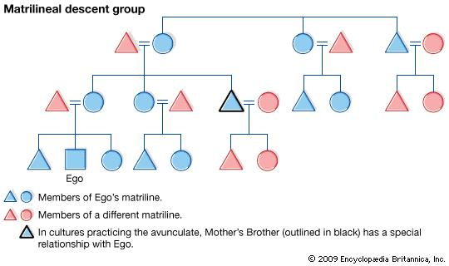
Sociology of Kinship
Kinship: Relation by the bond of blood, marriage etc.
Represents one of the basic social institutions.
Approaches:
Study the process through which descent is drawn, the manner in which family trees and drawn, the manner in which inheritance is established.

Slide 14
Sociology of Kinship
QUESTIONS:
HOW is AUTHORITY exerted in different kinship patterns?
HOW do authority/residence patterns change with time? WHY? WHAT is the impact of these changes?
HOW do kinship patterns change over time?
  Reimaging FAMILIES/RELATIONSHIPS. Joint → Nuclear
  NEW relationships? New forms of communication?
G. S. Ghurye, Patricia Uberoi

Slide 15
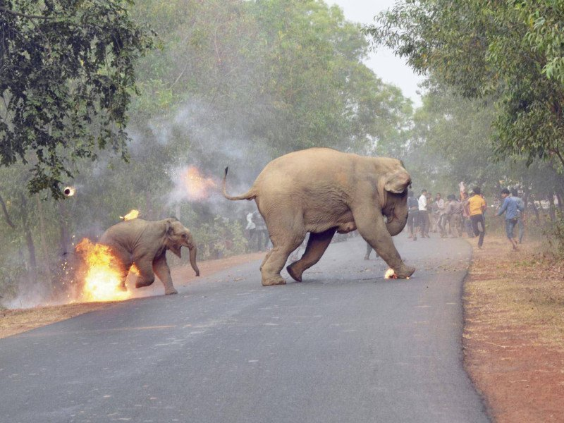

Slide 16
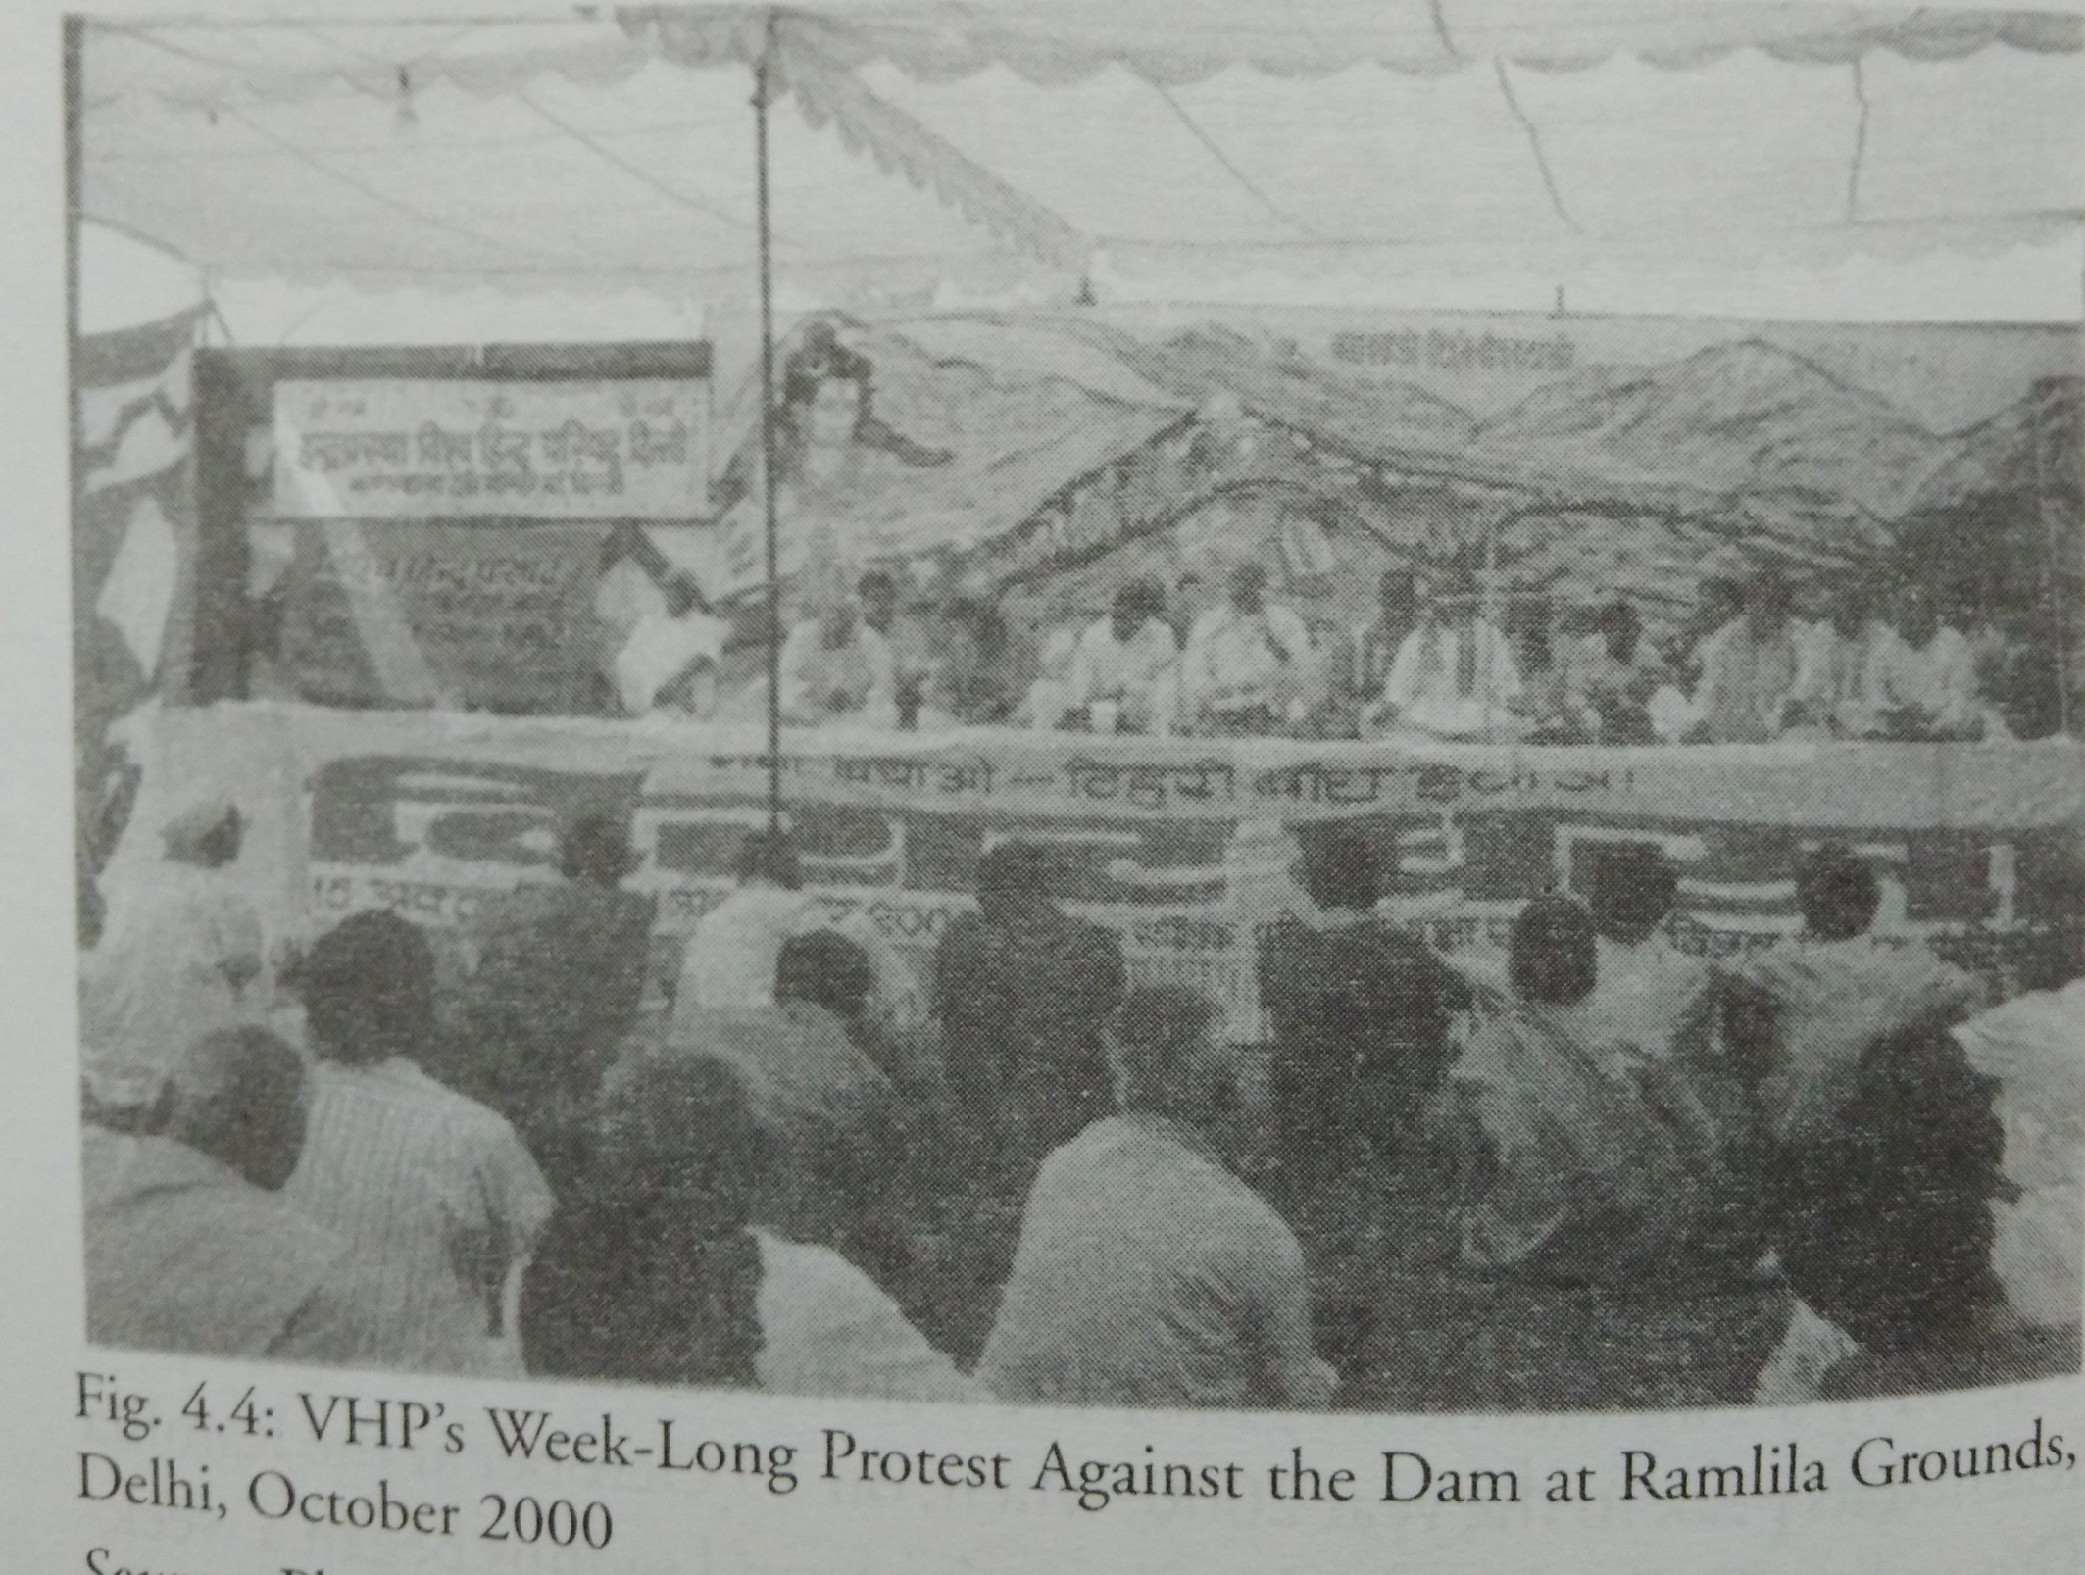
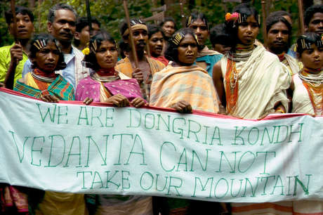

Slide 17
Environment and Sociology
Study of relations between human societies and biophysical environments.
Ecological Change:
Agrarian Change/Forest Transformation
Impact of ‘Development’ projects
QUESTIONS:
WHAT does ecological change (-> Urbanization/Migration) do to:
  Social structures
  Community/Support Networks, family relationships
  Access to natural resources and LOCAL power relations
  WHAT does the study of ‘environmental’ movements tell us about:
  WHO and WHAT is being mobilized? Relationship between environmental/political/cultural mobilization.
  ‘Identity’ being constructed/reinforced.

Slide 18
Environment and Sociology
QUESTIONS:
Who participates in environmental movements? Social/political/economic profile? WHY?
HOW do environmental ‘problems’ emerge? WHAT are the forces/situations/factors which establish an ‘ecological’ problem?
ROLE of role of activists, ecological movements, media etc.
Who is seen as an environmental defender and who is NOT? WHY?
Ramachandra Guha - The Unquiet Woods, Varieties of Environmentalism
Amita Baviskar - In the Belly of the River
Nandini Sundar - Legal Grounds: Natural Resources, Identity and the Law in Jharkhand

Slide 19
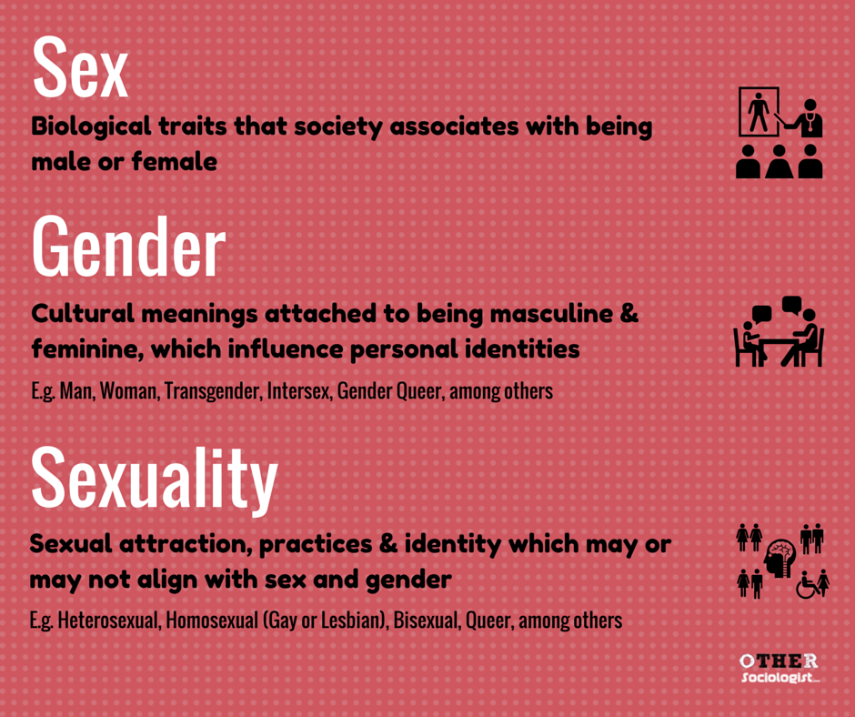
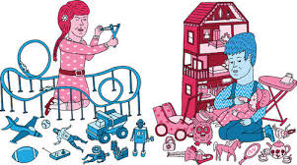
Sociology of Gender
QUESTIONS:
HOW is ‘masculinity’ and ‘feminity’ constructed?
WHY is there a UNIVERSAL secondary status of women in society?
WHY are there HUGE differences in cultural conceptions of women and men?

Slide 20
Gender and Sociology
  Portrayal of the ideal (deified) woman as the pure virgin, the loyal and obedient wife, the mother (Mother/Whore, Wife/Vamp)
  TROPISATION of women (Read Patricia Oberoi). As symbols/signifiers of caste/race status, religious pride, national honour etc.
Features common to ALL women, across class, caste, marital status:
Violence and harassment.
Discrimination in the workplace.
Limited access to rights. e.g. political participation, legal rights.
  Class and Gender. Women as STATUS groups, housewives as an economic CLASS?
How do women play a role in constructing/maintaining/reproducing the caste structure? GREATER pressure on women.
What is the interplay between gender and caste? Dalits as ONLY male, women as ONLY ‘upper caste’.

Slide 21
Urban Sociology
Study of life and human interactions in urban areas, in cities.
Structures, processes and changes of an urban area
Urbanisation. Social alienation, shift in the structure/role of families? Urban-rural continuum, globalisation
CULTURAL and ECOLOGICAL aspects:
The ‘culture’ of urban areas, impact on stratification, class, caste and gender.
Built environment and its impacts
Migration
Slums
Specific cultures

Slide 22
Political Sociology
Study of POWER
  Different WAYS of exerting authority. RATIONAL/TRADITIONAL/CHARISMATIC
  Different forms of power in different political SYSTEMS.
  Authoritarianism/Democracy. Nature of participation/internal working of institutions/Internal structures.
Study of the relationship between communities, societies and power structures
  Political elites and non-elites. Composition and recruitment. Changing profile of political elites?
  Power elites. Composition and nature of power.
  Methods of political mobilisation. WHAT sentiment is tapped? EXAMPLE: AAP/BJP/Patidar movement

Slide 23
Political Sociology
Conflict and change
Challenges to power
  Nature and compositions of social movements.
  Questions raised by social movements.
  Impact of social movements.
Challenges to DOMINANT ideas. Questions of nation-state, citizenship, state violence, etc.
Bimol Akoijam, Neera Chandoke, MSS Pandian, Nivedita Menon, Zoya Hasan

